Slide 1
Microsoft Dynamics AX 2012 Administration Workshop Chapter 3: Manage Users and Security

Slide 2
Conditions and Terms of Use
Microsoft Confidential
This training package is proprietary and confidential, and is intended only for uses described in the training materials. Content and software is provided to you under a Non-Disclosure Agreement and cannot be distributed. Copying or disclosing all or any portion of the content and/or software included in such packages is strictly prohibited.
The contents of this package are for informational and training purposes only and are provided "as is" without warranty of any kind, whether express or implied, including but not limited to the implied warranties of merchantability, fitness for a particular purpose, and non-infringement.
Training package content, including URLs and other Internet Web site references, is subject to change without notice. Because Microsoft must respond to changing market conditions, the content should not be interpreted to be a commitment on the part of Microsoft, and Microsoft cannot guarantee the accuracy of any information presented after the date of publication. Unless otherwise noted, the companies, organizations, products, domain names, e-mail addresses, logos, people, places, and events depicted herein are fictitious, and no association with any real company, organization, product, domain name, e-mail address, logo, person, place, or event is intended or should be inferred.
Copyright and Trademarks
© 2013 Microsoft Corporation. All rights reserved.
Microsoft may have patents, patent applications, trademarks, copyrights, or other intellectual property rights covering subject matter in this document. Except as expressly provided in written license agreement from Microsoft, the furnishing of this document does not give you any license to these patents, trademarks, copyrights, or other intellectual property.
Complying with all applicable copyright laws is the responsibility of the user. Without limiting the rights under copyright, no part of this document may be reproduced, stored in or introduced into a retrieval system, or transmitted in any form or by any means (electronic, mechanical, photocopying, recording, or otherwise), or for any purpose, without the express written permission of Microsoft Corporation.
For more information, see Use of Microsoft Copyrighted Content at http://www.microsoft.com/about/legal/permissions/
Microsoft®, Internet Explorer®, Outlook®, SkyDrive®, Windows Vista®, Zune®, Xbox 360®, DirectX®, Windows Server®, Microsoft Dynamics® and Windows® are either registered trademarks or trademarks of Microsoft Corporation in the United States and/or other countries. Other Microsoft products mentioned herein may be either registered trademarks or trademarks of Microsoft Corporation in the United States and/or other countries. All other trademarks are property of their respective owners.

Slide 3
Students: How to View this Presentation
Switch to Notes Page view
Click View on the ribbon and select Notes Page
Use page up or page down to navigate
Zoom in or out as needed
Most slides will have supporting text that you can view now or after the delivery
Add notes to your copy of the presentation if you want to
You take the presentation files home with you.

Slide 4
Overview
Provide an overview of the security system and elements
Types of authentication
Authorization using role-based security
Security policies
Segregation of duties

Slide 5
Objectives
Gain an understanding of the security system and elements including:
Types of authentication
How to create users
Components of role based security
Assign roles to users:
Manually and Automatically
Organization model
Assign roles to the organization model
Extensible data security policy framework
Customize security
Create segregation of duty rules

Slide 6
Introduction
Security Objectives:
Keep sensitive data safe
Keep users focused on their roles
Keep the system as streamlined as possible
Notes:
Microsoft Dynamics AX offers many security and configuration options. Knowing how to implement these options will help companies cover their security needs.

Slide 7
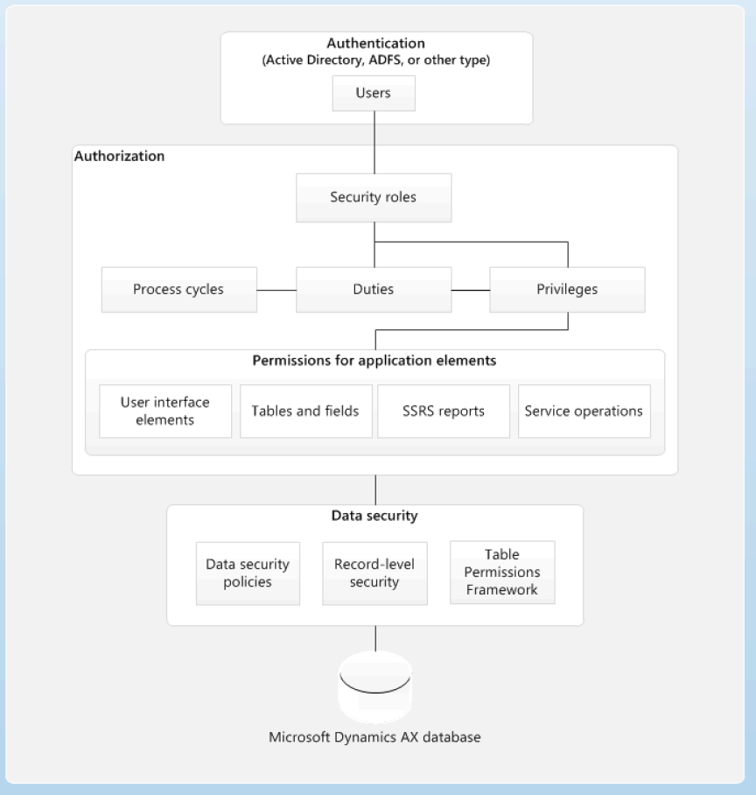
Security Overview
Authentication
Data security
Role-based security
Default and sample security definitions
Compliance, auditing, and reporting
Server enforcement of security
Flexible authentication
Security integration with the Org model
Notes:
Security Overview
Understanding the security architecture of Microsoft Dynamics AX can help you customize security to fit your business needs.
The diagram on the slide above provides a high-level overview of Microsoft Dynamics AX security architecture.
“Microsoft Dynamics AX 2012 has several security layers and elements available to filter who and what can be accessed.
Lets take a look into the different elements to understand the possibilities and usages.”

Slide 8

Security Overview (continued)
Authentication
To Identify user.
Authorization
To Grant Access to application elements
Data security
To Deny Access to:
Tables
Fields
Rows
Notes:
Authentication
By default, only authenticated users who have rights in Microsoft Dynamics AX can establish a connection.
Microsoft Dynamics AX uses integrated Windows authentication to authenticate Active Directory users. If you configure Microsoft Dynamics AX to use a different authentication provider, users are authenticated by that provider.
After a user connects to Microsoft Dynamics AX, access is determined by the duties and privileges assigned to the security roles that the user belongs to.
Data Security
Authorization is used to grant access to elements of the application. In contrast, data security is used to deny access to tables, fields, and rows in the database.

Slide 9
Security Overview (continued)
Extensible Data Security framework
to control access to transactional data by assigning…
data security policies
To restrict data based on specific criteria.
Record-level security
To limit access to data based on a query.
It will be deprecated, do not use it, use Extensible Data Security (EDS)
Table Permissions Framework
Security enforced by AOS
Extensible Data Security
Notes:
Use the extensible data security framework to control access to transactional data by assigning data security policies to security roles. Data security policies can restrict data based on effective date or based on user data such as sales territory or organization.
In addition to the extensible data security framework, the record-level security feature can be used to limit access to data based on a query.
Some data is additionally protected by the Table Permissions Framework. Data security for specified tables is enforced by the AOS. Data is not sent to the client if the user does not have access to that data.
Best Practice: Because the record-level security feature will be deprecated in a future release of Microsoft Dynamics AX, it is recommend using data security policies instead.

Slide 10
Security Overview (continued)
Role-based security
Users are assigned to roles
Access is granted to security roles.
A user assigned to a security role has access to the set of privileges that is associated with that role.
No role, no privilege
Users are assigned to security roles based on:
Responsibilities
Participation in business processes.
Grant access to duties that users in a role perform, not to the program elements they must use.
Notes:
Role Based Security
In role-based security, access is not granted to individual users, only to security roles. Users are assigned to roles. A user who is assigned to a security role has access to the set of privileges that is associated with that role. A user who is not assigned to any role has no privileges.
In Microsoft Dynamics AX, role-based security is aligned with the structure of the business. Users are assigned to security roles based on their responsibilities in the organization and their participation in business processes. The administrator grants access to the duties that users in a role perform, not to the program elements that users must use.

Slide 11
Security Overview (continued)
Caution:
It adds Complexity
SoD
Notes:
Because rules can be set up for automatic role assignment, the administrator does not have to be involved every time the user's responsibilities change. Managers can control day-to-day user access based on business data.
To build the framework we do it from bottom to top. To use the framework we do it from top to bottom
- To set it up:
First we assign specific privileges for application elements.
These privileges are then mapped to specific duties.
We can create collection of Duties named Process Cycles.
Then we assign duties to roles.
- At run time:
When a user tries to access an application element the roles it belongs to are evaluated.
The duties (and privileges) associated for those roles are identified and privilege level to the element being requested is resolved.

Slide 12
Default and Sample Security Definitions
Permissions for all application elements are created and grouped into out-of-box, task-based roles and duties.
In previous versions, no security settings were provided by default.
Example:
The administrator no longer has to grant access to the Create sales order form and all of the related application objects.
Instead, the administrator can grant access to the Maintain sales order duty, which includes all of the permissions that are required to view, create, modify, and delete sales orders.
Notes:
Sample security roles and duties make security easier to set up. Roles and duties are provided for every area of Microsoft Dynamics AX, and relevant privileges are assigned to these roles and duties by default. You can use the sample security roles and duties as they are, modify them to fit the needs of your business, or create new security roles and duties.
Recommendation is:
Use the Roles already defined.
If none of them meet your needs:
- Copy and adapt one that is close to what is required by creating the missing duties and associated privileges and remove what is not needed.
- Build a new set of required privileges to perform the duty or duties and assign the duty to the new or customized role.

Slide 13
Compliance, Auditing, and Reporting
Segregation of duties rules to prevent access to conflicting duties.
You might set up a rule specifying one person cannot both acknowledge the receipt of goods and pay the vendor.
Security audit trail reports.
Using these audit trails, security reports, and role based security, administrators and auditors can more easily receive information about each user's permissions.
Notes:
Compliance, Auditing, and Reporting
You can set up segregation of duties rules to make sure that a user does not have access to conflicting duties (permissions required to perform a task or service for a job). For example, you might set up a rule specifying one person cannot both acknowledge the receipt of goods and pay the vendor.
In addition to helping you enforce compliance, Microsoft Dynamics AX 2012 includes security audit trail reports. Using these audit trails, security reports, and role based security, administrators and auditors can more easily receive information about each user's permissions. Doing this makes it easier to determine whether adjustments to security must be made.
Segregation of Duties refers to conflicting Duties, not to Privileges

Slide 14
Server Enforcement of Security
Table Permissions Framework (TPF)
Allows authorization at the server level to deny users access to full records and individual fields.
This helps to increase the consistency of security between client types.
Flexible Authentication
Users can be authenticated by using methods other than Active Directory.
This means external users do not require domain accounts to access Microsoft Dynamics AX.
This simplifies the setup and maintenance required by administrators especially for external users.

Slide 15
Security Integration with the Organization Model
Users can view or edit data in different organizational structures
A user might enter records in Human Capital Management by using a human resources organization hierarchy and enter financial transactions by using a legal entity organization hierarchy.
Data security filters take the hierarchical structure into consideration.
It’s possible to specify a company context for a particular user in a role.
Only organization hierarchies given the security organization hierarchy purpose can be used for security.
Notes:
Security Integration with the Organization Model
In Microsoft Dynamics AX 2012 users can view or edit data in different organizational structures, instead of just the company they are logged on to. For example, a user might enter records in Human Capital Management by using a human resources organization hierarchy and enter financial transactions by using a legal entity organization hierarchy.
Data security filters take the hierarchical structure into consideration.
For example, you can set up a filter that applies to the current organization and any organizations underneath it in the hierarchy.
IMPORTANT: Some tables in Microsoft Dynamics AX 2012 contain a DataAreaId column.
To help secure data in these tables, the administrator can specify a company context for a particular user in a role.
NOTE: Before an organization hierarchy can be used for security it must be given the security organization hierarchy purpose.

Slide 16
Authentication
Active Directory users
Active Directory group
Integration with Sharepoint Pluggable Authentication (SPA).
Claims user – AD FS
Forms Based Authentication (FBS) - database of users.
Live Id.
Custom Security Token Services (STS)
Windows Identity Foundation APIs
Security Assertion Markup Languge (SAML)
Notes:
Authentication
Users are created by using Active Directory users, Active Directory groups, or by using pluggable authentication.
Active Directory Users
You can use Active Directory users to control the security access to users on an individual basis. This is useful when each user has different access to the system and multiple users do not share the same access.
Active Directory Groups
Active Directory groups can be used as an authentication type within Microsoft Dynamics AX 2012. Roles are added directly to the groups similar to Active Directory users. If a user is associated with an Active Directory user and group, that user receives the duties and privileges of both sets of roles.
Claims Users
Pluggable authentication can be used with Microsoft Dynamics AX 2012, and is used to allow access to Enterprise Portal to users who are not part of Active Directory.
Microsoft Dynamics AX 2012 integrates with SharePoint Pluggable authentication to provide authentication to Enterprise Portal users not in an organization's Active Directory.

Slide 17
Notes Continued
Notes:
Pluggable authentication provides an administrator three additional forms of authentication in addition to Active Directory:
Active Directory Federated Service (AD FS),
Forms Based Authentication (FBS)
Live Id.
Active Directory Federated Service: Allows users who are associated with an external Active Directory to access Enterprise Portal. When an AD FS user is removed from the external Active
Directory that user does not have access to Enterprise Portal.
Forms Based Authentication: Allows users to authenticate against a custom database of users.
Live ID: Users can authenticate to Enterprise Portal by using Windows Live Id.
Note: Custom Security Token Services (STS) using Windows Identity Foundation APIs and Security Assertion Markup Language (SAML) are also supported.

Slide 18
Authentication (continued)
Active directory users
Active directory groups
If a user is associated with an Active Directory user and group, that user receives the duties and privileges of both sets of roles.
Notes:
AUTHENTICATION
Users are created by using Active Directory users, Active Directory groups, or by using pluggable authentication.
Active Directory Users
You can use Active Directory users to control the security access to users on an individual basis. This is useful when each user has different access to the system and multiple users do not share the same access.
Active Directory Groups
Active Directory groups can be used as an authentication type within Microsoft Dynamics AX 2012. Roles are added directly to the groups similar to Active Directory users. If a user is associated with an Active Directory user and group, that user receives the duties and privileges of both sets of roles.
If a user is associated with an Active Directory user and group, that user receives the duties and privileges of both sets of roles.

Slide 19
Authentication - Pluggable Authentication
Claims users
Allows access to Enterprise Portal to users who are not part of Active Directory.
When an ADFS user is removed from the external Active Directory that user does not have access to Enterprise Portal.
Tip: ADFS -> If the federation trust is discontinued all claims checks will prevent access to all users that relay on it.
Forms Based Authentication (FBS)
Authenticate against a custom database of users.
Using Windows Live ID
Notes:
Claims Users
Pluggable authentication can be used with Microsoft Dynamics AX 2012, and is used to allow access to Enterprise Portal to users who are not part of Active Directory.
Microsoft Dynamics AX 2012 integrates with SharePoint Pluggable authentication to provide authentication to Enterprise Portal users not in an organization's Active Directory.
Pluggable authentication provides an administrator three additional forms of authentication in addition to Active Directory:
Active Directory Federated Service (AD FS)
Forms Based Authentication (FBS)
Live ID.
Active Directory Federated Service: Allows users who are associated with an external Active Directory to access Enterprise Portal. When an AD FS user is removed from the external Active Directory that user does not have access to Enterprise Portal.
Forms Based Authentication: Allows users to authenticate against a custom database of users.
Live ID: Users can authenticate to Enterprise Portal by using Windows Live ID.

Slide 20
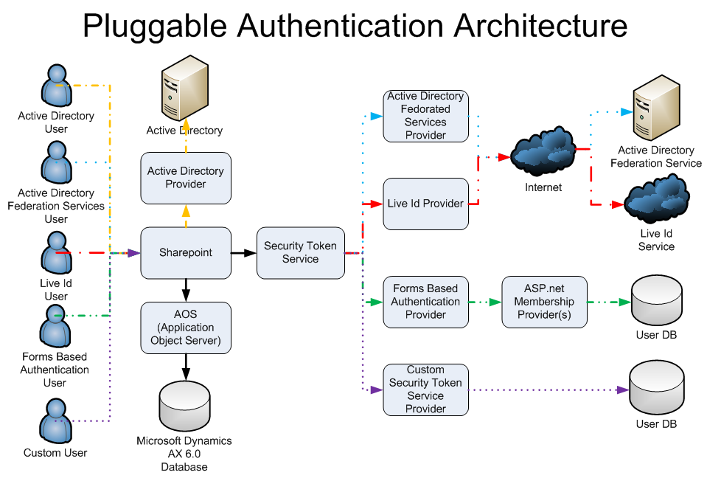
Pluggable Authentication Architecture
Notes:
Note: Custom Security Token Services (STS) using Windows Identity Foundation APIs and Security Assertion Markup Language (SAML) are also supported.

Slide 21
Pluggable Authentication Architecture (continued)
Notes:
Note: Custom Security Token Services (STS) using Windows Identity Foundation APIs and Security Assertion Markup Language (SAML) are also supported.

Slide 22
Pluggable Authentication Architecture (continued)
Notes:
Note: Custom Security Token Services (STS) using Windows Identity Foundation APIs and Security Assertion Markup Language (SAML) are also supported.

Slide 23
Pluggable Authentication Architecture (continued)
Notes:
Note: Custom Security Token Services (STS) using Windows Identity Foundation APIs and Security Assertion Markup Language (SAML) are also supported.

Slide 24
Pluggable Authentication Architecture (continued)
Notes:
Note: Custom Security Token Services (STS) using Windows Identity Foundation APIs and Security Assertion Markup Language (SAML) are also supported.

Slide 25
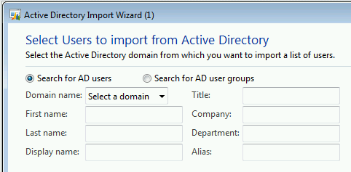
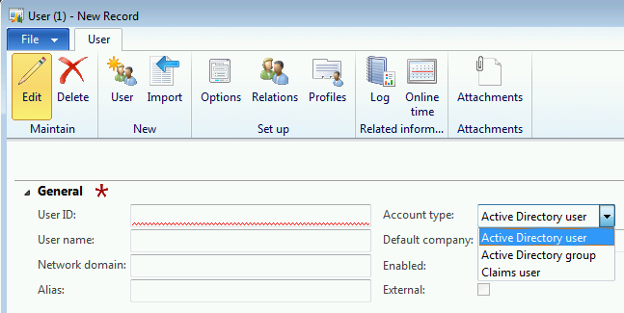
Adding Users
Overview
Procedure: Manually create a user
Notes:
Adding Users
You can use Active Directory users to control the security access to users on an individual basis. This is useful when each user has different access to the system and multiple users do not share the same access.

Slide 26
Adding Users (Scenario)
You would like to add Nancy, a new Sales Rep, as a user to Microsoft Dynamics AX 2012. Nancy is an employee of Contoso and has already been added to Active Directory as a user.
System administration > Common > Users > Users.
Notes:
Scenario: Adding Users
You would like to add Nancy, a new Sales Rep, as a user to Microsoft Dynamics AX 2012. Nancy is an employee of Contoso and has already been added to Active Directory as a user.
Procedure: Manually Create a User
To add Nancy as a user, follow these steps:
Open System administration > Common > Users > Users.
Click User in the New group of the Action Pane.
In the User Id field, type "Nancy."
In the User name field, type "Nancy Anderson."
In the Network domain field, type "CONTOSO."
In the E-mail address / alias field, type "Nancy."
Confirm the Account type field is set to "Active Directory user".
Change Default company to “CEU”
Select Enabled.
Click Close.
Note: At this point, a user is created but no permissions are given to this user.

Slide 27
Scenario: Adding Active Directory Groups as Users
Procedure: Manually create active directory groups as users
Group Name: “AXAdmin”.
System administration > Common > Users > Users.
NOTE: Group members are granted access to the system.
If a user is added to the Active Directory group, the worker will be automatically granted access.
If user is removed from the Active Directory group, access is removed.
NOTE: The users are created but no permissions were given.
Notes:
Adding Active Directory Groups as Users
Active Directory groups can be used as an authentication type within Microsoft Dynamics AX 2012. Roles are added directly to the groups similar to Active Directory users. If a user is associated with an Active Directory user and group, that user receives the duties and privileges of both sets of roles.
Procedure: Manually Create Active Directory Groups
Within AX, add the Active Directory Group, “AXAdmin” as a user in AX:
Open System administration > Common > Users > Users.
Click User in the New group of the Action Pane.
In the User Id field, type a unique identifier for the group such as "AXAdmin".
In the User name field, type a description for the group such as "AX Administrators".
In the Network domain field, enter the domain such as CONTOSO.
In the E-mail address / alias field, type the alias of the Active Directory group such as "AXAdmin".
Confirm the Account type field is set to "Active Directory group".
Set the Default company to “CEU”
Select the Enabled check box.
Click Close.

Slide 28
Notes Continued
Notes:
Note: Each of the users that are assigned to the AXAdmin Active directory group can now access the system. If a user is added to the Active directory group from inside Active Directory, the worker will be automatically granted access to the system. Likewise if a worker is removed from the Active Directory group from inside Active Directory, their access to Microsoft Dynamics AX is automatically removed.
Note: At this point the users are created but no permissions are given to this user.

Slide 29
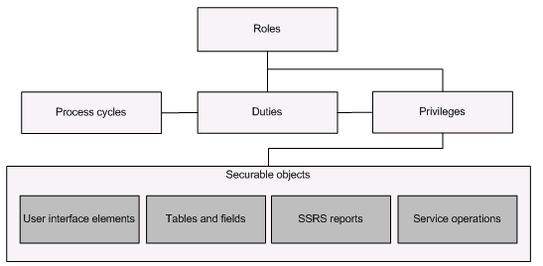
Role-Based Security
Roles are a group of duties for a job function, such as sales manager
Process cycles are groups of duties for organizational purposes, such as accounting process cycle
Duties are composed of a group of privileges required for a specific business function, such as maintaining bank transactions
Privileges are composed of permissions and represent access to tasks, such as canceling payments and processing deposits
Permissions represent access to individual securable objects, such as menu items and tables
Notes:
Role Based Security
This section provides an overview of the elements of role-based security in Microsoft Dynamics AX. The security model is hierarchical, and each element in the hierarchy represents a different level of detail.
Roles are a group of duties for a job function, such as sales manager
Process cycles are groups of duties for organizational purposes, such as accounting process cycle
Duties are composed of a group of privileges required for a specific business function, such as maintaining bank transactions
Privileges are composed of permissions and represent access to tasks, such as canceling payments and processing deposits
Permissions represent access to individual securable objects, such as menu items and tables
Both duties and privileges can be assigned to roles to grant access to Microsoft Dynamics AX.
The illustration on the slide above shows the elements of role-based security and their relationships.

Slide 30
Role-Based Security (continued)
Roles
Process cycles
Duties
Privileges
Permissions over Securable objects
UI elements
Tables & Fields
SSRS Reports
Service Operations
Notes:
Role Based Security

Slide 31
Role-Based Security (continued)
Roles
Process cycles
Duties
Privileges
Permissions over Securable objects
UI elements
Tables & Fields
SSRS Reports
Service Operations
Notes:
Role Based Security
Comment: Now that we know what we are doing, let’s re-design it like this….
1 process cycle maps a set of Duties.
A set of duties maps to the required privileges.
Each privilege assign the permission to each element.
Now, this is not what we link to the role.

Slide 32
Role-Based Security (continued)
Roles
Process cycles
Duties
Privileges
Permissions over Securable objects
UI elements
Tables & Fields
SSRS Reports
Service Operations
Notes:
Role Based Security
Comment:
Only Duties and Privileges are mapped to roles.
Try not to assign privileges directly to roles.
Only those are evaluated for permissions and can be managed within Microsoft Dynamics AX mapping them to a Role.
The permissions will be evaluated at run time and they need to be created using the Microsoft Dynamics AX Development environment.

Slide 33
Role-Based Security (continued)
Application security aligned with your business
Reusable permissions
Security roles
Process cycles
Duties
Privileges
Permissions and Entry points
Role design principles
Procedure: Auto assign roles to users
Procedure: Manually assign roles to users
Procedure: Assign roles to org unit/legal entities

Slide 34
Application Security Aligned with Your Business
users are assigned to roles based on:
Responsibilities in the organization
Participation in business processes.
Rules can be set up for automatic assignments of a user's responsibilities change.
After security roles and rules are set up, role assignments can be updated based on changes in business data.
Notes:
Application Security Aligned with your Business
In Microsoft Dynamics AX 2012, security is role-based, and many security roles and duties are provided to help base security definitions. Using role-based security, users are assigned to roles, based on their responsibilities in the organization and their participation in business processes. Instead of identifying and granting access to application elements, the administrator assigns duties which users in the role perform.
Because rules can be set up for automatic role assignment, the administrator does not have to be involved every time a user's responsibilities change. After security roles and rules are set up, role assignments are updated based on changes in business data.

Slide 35
Reusable Permissions
Single set of roles applies across all companies and organizations
“The administrator no longer has to create and maintain separate user groups for each company, as was the case in earlier versions.“
Roles are not specific to a company or organization.
But Administrator can still specify a company or organization context for a particular user in a role.
Notes:
Reusable Permissions
In Microsoft Dynamics AX 2012, a single set of roles applies across all companies and organizations. The administrator no longer has to create and maintain separate user groups for each company, as was the case in earlier versions.
Even though roles themselves are not specific to a company or organization, the administrator can still specify a company or organization context for a particular user in a role.

Slide 36
Security Roles
User must be assigned to a role to have any access.
It is possible to filter access to data based on role and time.
Security roles can be organized into a hierarchy.
80+ sample security roles out of the box.
All functionality is associated with at least one of the sample security roles.
All users assigned to default System user role to log on.
Sample security roles do not correspond to Role Centers.
Notes:
Security Roles
All users must be assigned to at least one security role in order to have access to Microsoft Dynamics AX.
Roles consist of the following:
Represent a behavior or pattern a person can play
Includes a defined set of application access privileges
Can have users assigned to one or more security roles
The security roles that are assigned to a user determine the duties that the user can perform and the parts of the user interface that the user can view.
Administrators can apply data security policies to limit the data that the users in a role have access to. For example, a user in a role may have access to data only from a single organization.
The administrator can also specify the level of access that the users in a role have to current, past, and future records. For example, users in a role can be assigned privileges that allow them to view records for all periods, but that allow them to modify records only for the current period.

Slide 37
Notes Continued
Notes:
Security roles are defined one time for all organizations. In addition, users can be automatically assigned to roles based on business data. For example, the administrator can set up a rule that associates a Human resources position with a security role. Any time that users are assigned to that position, those users are automatically added to the appropriate security roles.
Security roles can be organized into a hierarchy. A role hierarchy enables roles to be defined as combinations of other roles. For example, the sales manager role can be defined as a combination of the manager role and the salesperson role.
In the security model for Microsoft Dynamics AX, duties and privileges are used to grant access to the program. For example, the sales manager role can be assigned the Maintain revenue policies and Review sales orders duties.
By default, 80+ sample security roles are provided out of the box. All functionality in Microsoft Dynamics AX is associated with at least one of the sample security roles.
The administrator can assign users to the sample security roles, modify the sample security roles to fit the needs of the business, or create new security roles.
Note: By default, each user is assigned to the System user role which gives them basic privileges needed to log into Microsoft Dynamics AX. Also, by default the sample roles are not arranged in a hierarchy.
Note: The sample security roles do not correspond to Role Centers.

Slide 38
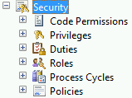
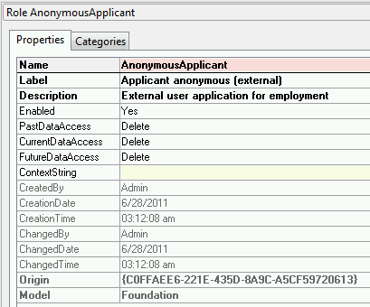
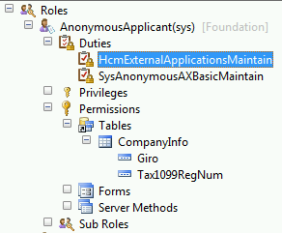
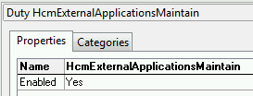
AOT/Security/Roles
Notes:
The slide shows a Role and its properties within the AOT.

Slide 39
Process Cycles
In security model:
Business processes are referred to as process cycles.
For example, in the Accounting Process Cycle:
You may find the Maintain ledgers and Maintain bank transactions duties.
Notes:
Process Cycles
A business process is a coordinated set of activities in which one or more participants consume, produce, and use economic resources to achieve organizational goals.
To help the administrator locate the duties that must be assigned to roles, duties are organized by the business processes that they are part of. In the context of the security model, business processes are referred to as process cycles. For example, in the accounting process cycle, you may find the Maintain ledgers and Maintain bank transactions duties.
Note: Process cycles are used for organization only. The process cycles themselves cannot be assigned to roles.
Best Practice: Although both duties and privileges can be assigned to security roles, we recommend that you use duties to grant access to Microsoft Dynamics AX.

Slide 40

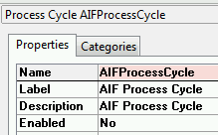
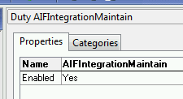
AOT/Security/Process Cycles
Notes:
The slide shows a Process Cycle element and its properties within the AOT.

Slide 41
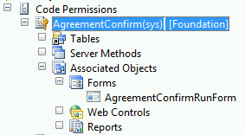
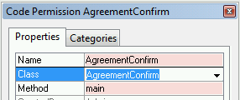
AOT/Security/Code Permissions
Notes:
The slide shows a Code Permission and its properties within the AOT.
This is not explained in the chapter but this can be used to grant permissions over specific classes and methods.

Slide 42
Duties
Business Processes → Duties → Security Roles.
Duty A -> Security Role 1.
Duty A -> Security Role 2.
Business Process X Includes Duty A and Duty B:
Duty A -> Security Role 1.
Duty B -> Security Role 2.
These duties are said to be segregated. Used to comply with regulatory requirements. (SOX), (IFRS) and FDA).
It helps reduce the risk of fraud, and helps to detect errors or irregularities.
700+ default duties are provided out of the box.
Modify the privileges that are associated with a duty, or create new duties.
Notes:
Duties
Duties correspond to parts of a business process. The administrator assigns duties to security roles. A duty can be assigned to more than one role.
In the security model for Microsoft Dynamics AX, duties contain privileges. For example, the Maintain bank transactions duty contains the Generate deposit slips and Cancel payments privileges.
You can assign related duties to separate roles. These duties are said to be segregated. By segregating duties, you can better comply with regulatory requirements, such as those from Sarbanes-Oxley (SOX), International Financial Reporting Standards (IFRS), and the United States Food and Drug Administration (FDA). In addition, segregation of duties helps reduce the risk of fraud, and helps you detect errors or irregularities.
700+ default duties are provided out of the box. The administrator can modify the privileges that are associated with a duty, or create new duties.
Best Practice: Privileges can be assigned directly to roles. However, for easier maintenance, we recommend that you assign only duties to roles.
Note: Only developers can create or modify permissions. Be aware that modifying permissions may affect your licensing requirements.

Slide 43
Notes Continued
Notes:
To summarize duties:
Duties are defined as a responsibility to perform one or more tasks or services for a job.
In the security model a duty is a set of application access privileges which are required for a user to perform their responsibilities.
Duties are designed for a specific business objective and correspond to parts of a business process

Slide 44
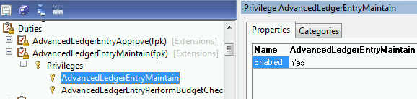
AOT/Security/Duties
Notes:
The slide shows a Duty and its properties within the AOT.

Slide 45
Privileges
Specifies the level of access that is required to perform a job, solve a problem, or complete an assignment.
A privilege contains:
Permissions to individual application objects:
User interface elements > Entry Points > Access Level.
Tables and forms > Permissions
By default, 6000+ privileges are provided.
Assign only duties to roles. They are easier to maintain.
Modify or create the permissions that are associated with a privilege.
Notes:
Privileges
In the security model for Microsoft Dynamics AX, a privilege specifies the level of access that is required to perform a job, solve a problem, or complete an assignment.
A privilege contains permissions to individual application objects, such as user interface elements and tables. For example, the Cancel payments privilege contains permissions to the menu items, fields, and tables that are required to cancel payments.
By default, 6000+ privileges are provided for all features in Microsoft Dynamics AX. The administrator can modify the permissions that are associated with a privilege, or create new privileges.
BEST PRACTICE: Privileges can be assigned directly to roles. However, for
easier maintenance, we recommend that you assign only duties to roles.

Slide 46
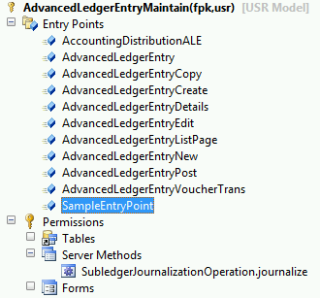
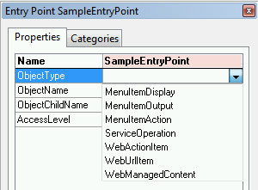
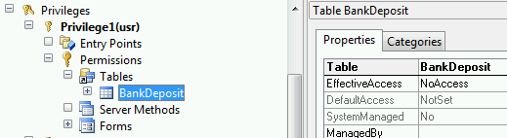
AOT/Security /Privileges
Notes:
The slide shows a Privilege and its properties within the AOT.
Do not confuse Duties with Privileges.
i.e.
To send a postal card or letter you need to complete several steps.
These steps require different skills, like writing the document, put it in an envelope, putting the stamp and giving it to the postman.
In this example the Duty will be to send a letter.
It will include several Privileges like getting access to the envelopes or access to the stamps.
We could split the privileges in a way that a user can send the envelopes but cannot have access stamps.
This scenario could be considered like a segregation of duties situation. And it can be achieved by splitting duties in to tasks and assign the specific privileges by tasks.

Slide 47
Permissions and Entry Points
Each function in Microsoft Dynamics AX is accessed through an entry point.
Menu items
Web content items
Service operations
There are 8000+ entry points out of the box.
Permissions group the securable objects and access levels that are required to run a function.
Tables, fields, forms or server side methods that are accessed through the entry point.
There are 20,000+ permissions out of the box.
Only developers can create or modify permissions and could affect licensing.
Notes:
Permissions and Entry Points
Each function in Microsoft Dynamics AX, such as a form or a service, is accessed through an entry point. Menu items, web content items, and service operations are referred to collectively as entry points. There are 8000+ entry points out of the box.
In the security model for Microsoft Dynamics AX, permissions group the securable objects and access levels that are required to run a function. This includes any tables, fields, forms or server side methods that are accessed through the entry point.
There are 20,000+ permissions out of the box.
Note: Only developers can create or modify permissions. Be aware that
modifying permissions may affect your licensing requirements.

Slide 48
Role Design Principles
Functional role: for example: Warehouse worker.
Organization role: for example: Employee.
Application role: for example: System User.
Role segregation categories:
Functional roles are designed to accommodate segregation of duties.
Different categories of roles exist that each focus on their type responsibilities.
Validation: Clerks focus on recording transactions.
Verification: Verifiers validate the correctness of recorded transactions.
Authorization: Supervisors authorize processing of the transactions.
Management: Managers review transactions periodically and apply changes to the process as appropriate.
Notes:
This slide is to identify the name schema and principles used while building the default Roles.
Role Design Principles
Several common design principles are used when creating the base 80+ roles. These design principles include the following:
Roles represent the common access rights that are required for the job positions within an organization.
Roles account for the organization size, culture and industry focus.
Users are assigned to one or more roles according to their job.
Role types.
Functional role: for example: Warehouse worker
Organization role: for example: Employee
Application role: for example: System User

Slide 49
Notes Continued
Notes:
Role segregation categories: Functional roles are designed to accommodate segregation of duties. Different categories of roles exist that each focus on their type responsibilities.
Validation: Clerks focus on recording transactions.
Verification: Verifiers validate the correctness of recorded transactions.
Authorization: Supervisors authorize processing of the transactions.
Management: Managers review transactions periodically and apply changes to the process as appropriate.

Slide 50
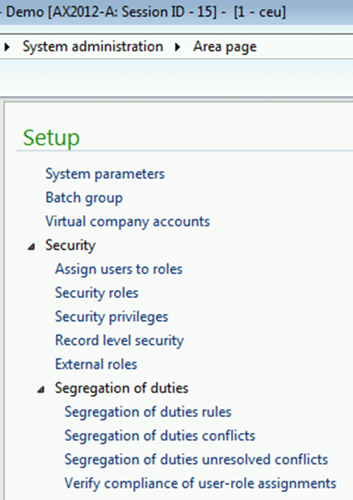
Scenario: Automatically Assign Roles to Users
You would like to give the “AXAdmin” user permissions as an Employee and Information Technology Manager so that whenever someone (Chris) is added to the “AXAdmin” Active Directory Group, they are automatically assigned this role in Microsoft Dynamics AX.
Assign “AXAdmin” to the roles of Employee and Information Technology Manager.
Assign Chris Ashton to the “AXAdmin” Active Directory Group.
Notes:
Procedure: Automatically Assign Roles to Users
To assign AXAdmin to the roles of Employee and Information Technology Manager, follow these steps:
Open System administration > Common > Users > Users.
Select the record for "AXAdmin."
On the top of the Users list page, click Edit.
In the middle of the User form, click Assign roles.
Select the records for "Employee" and "Information Technology Manager".
Click OK.
On the User form, click Close.
In the Roles for selected user FactBox on the top RH side, note "Employee" and "Information Technology Manager" are added as a role.
Note: The scenario on the notes section of slide 27 needs to be completed before starting this procedure.

Slide 51
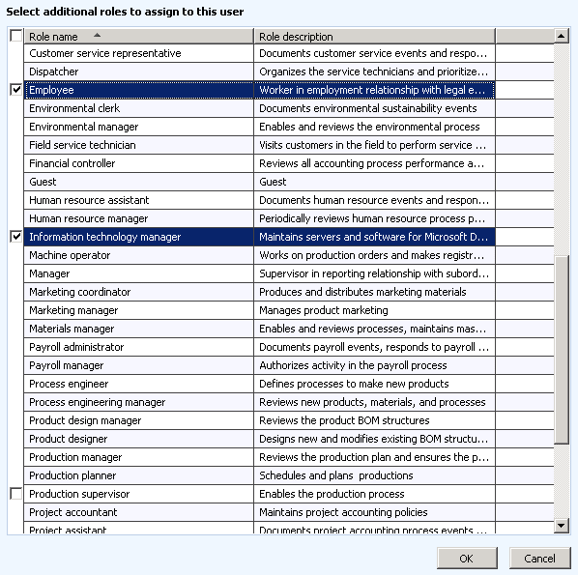
Select Roles
Notes:
Verify that Chris Ashton is not a user in Microsoft Dynamics AX
Open System administration > Common > Users > Users and verify that user Chris Ashton does not exist.
10. Assign Chris Ashton to the “AXAdmin” Active Directory Group in Windows:
Open Start>Administrative Tools>Active Directory Users and Computers
Under Users, double-click AXAdmin to open its properties.
Select the Members tab.
Click Add.
Login to the Dynamics AX client as Chris Ashton
Open the Admin Workshop folder on the desktop of your virtual machine.
Launch Chris.cmd from the folder CH03 Manage Users and Security\Run As Scripts\
Enter the password “pass@word1”
Close the Dynamics AX client
Open a Dynamics AX client as Administrator and see the account created for Chris.
Open System administration > Common > Users > Users and search for the alias chris.
NOTE: Notice the “$” in Chris’s User ID in Microsoft Dynamics AX. This is an indication that he is a user from an assigned AD group.

Slide 52
Scenario: Manually Assign Roles to Users
Give Nancy the Sales Rep permissions as an Employee, a Manager and as a Sales Manager.
Nancy has already been added as a user in Microsoft Dynamics AX 2012 and in Active Directory.

Slide 53
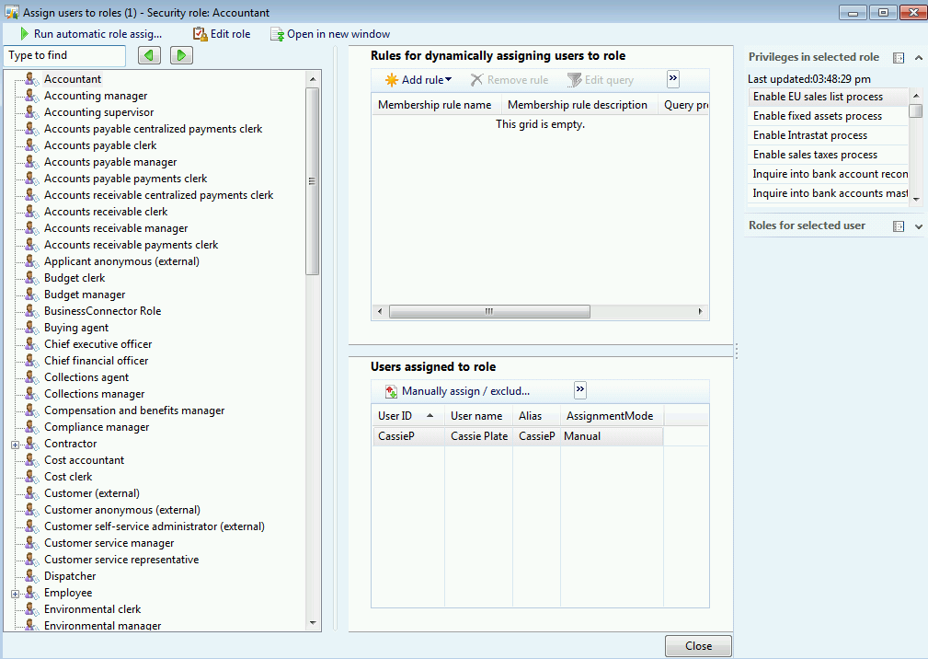
Scenario: Manually Assign Roles to Users
Assign Nancy to the roles of Employee and Manager in the Users form.
Assign Nancy to the role of Sales manager in the Security Role form.
Notes:
Scenario: Manually Assign Roles to Users
Give Nancy, the Sales Rep permissions as an Employee, Manager, and Sales Manager. Limit Nancy’s access as a manager and sales manager to companies under the main sales group in the "organizational" organization hierarchy. Nancy has already been added as a user in Microsoft Dynamics AX 2012 and in Active Directory.
Procedure: Manually Assign Roles to Users
To assign Nancy to the roles of Employee and Manager, follow these steps:
Open System administration > Common > Users > Users.
Select the record for "Nancy Anderson."
On the top of the Users list page, click Edit.
In the middle of the User form, click Assign roles.
Select the records for "Employee" and "Manager".
Click OK.
On the User form, click Close.
8. In the Roles for selected user FactBox on the upper right side, note "Employee" and "Manager" are added as a role.
NOTE: This procedure cannot be completed unless Procedure: Add a User has
been completed.

Slide 54
Notes Continued
Notes:
Procedure: Manually Assign Users to Roles
To assign Nancy to the role of Sales manager in an alternative way, follow these
steps:
1. Open System administration > Setup > Security > Assign users to
roles.
2. Highlight the role "Sales manager."
3. In the center of the Assign users to roles form, click Manually assign /
exclude users.
4. Highlight the record for "Nancy Anderson."
5. At the top of the Assign user to or exclude user from this role form,
click Assign to role.
6. Click Close.
7. Notice "Nancy Anderson" has been added to the Sales manager role.
8. Close the Assign users to roles form.
Note: This procedure cannot be completed unless the procedure: Add a User has
been completed.

Slide 55
Scenario: Assign Roles to Legal Entities/ Subsidiaries
Objectives:
To give April permissions as an Employee, Accounts payable clerk, and Accounts receivable clerk.
Current Situation: Currently she belongs to all of these roles but Accounts receivable clerk so he will need to add her to that role. She also needs to be removed from the Accounts payable payments clerk role as she will no longer be responsible for payments.
Security Purpose:
You would also like to limit April’s access as an Accounts payable clerk and Accounts receivable clerk to different legal entities and their subsidiaries so you must assign the CGRP - Legal Entities Organization hierarchy to the Security purpose.
Notes:
Scenario: Assign Roles to Legal Entities/Subsidiaries
You would like to give April, permissions as an Employee, Accounts payable clerk, and Accounts receivable clerk. Currently she belongs to all of these roles but Accounts receivable clerk so you will need to add her to that role. She also needs to be removed from the Accounts payable payments clerk role as she will no longer be responsible for payments.
You would also like to limit April’s access as an Accounts payable clerk and Accounts receivable clerk to different legal entities and their subsidiaries so he must assign the CGRP - Legal Entities Organization hierarchy to the Security purpose.
Procedure: Assign Roles to Legal Entities/Subsidiaries
To limit the companies that April has access to in the Accounts payable clerk and Accounts receivable clerk roles to those under "Contoso Entertainment Systems USA" for the Accounts payable clerk role and “Contoso Entertainment Systems Europe” in the "CGRP - Legal Entities" organization hierarchy, follow these steps:
Note: Organizational units must be assigned to the Security purpose if you want to secure individual organization units.

Slide 56
Procedure: Assign Roles to Legal Entities/ Subsidiaries
Add April to the Accounts receivable clerk role and remove her from the Accounts payable payments clerk role.
Set up the "CGRP - Legal Entities" organization hierarchy for the security purpose.
Limit the access that April has as Accounts payable clerk to the Contoso Entertainment Systems USA company.
Limit the access that April has as Accounts receivable clerk to the Contoso Entertainment Systems Europe company.
Log into the system to verify that April has Accounts payable clerk rights in CEU but not CEE and that she has Accounts receivable clerk rights in CEE but not CEE.
Notes:
Add April to the Accounts receivable clerk role and remove her from the Accounts payable payments clerk role
Open System administration > Common > Users > Users.
Select the record for "April Stewart."
On the top of the Users list page, click Edit.
In the middle of the User form, click Assign roles.
Select the records for "Accounts receivable clerk".
Highlight the Accounts payable payments clerk role
Click remove.
Click OK.
On the User form, click Close.
2. Set up the "CGRP - Legal Entities" organization hierarchy for the security purpose:
Go to Organization administration > Setup > Organization > Organization hierarchy purposes.
Select the "Security" purpose, and then click Add.
Select “CGRP - Legal Entities", then click OK.

Slide 57
Notes Continued
Notes:
(Optional) click View hierarchy, to view the "Organizational“ organization hierarchy structure.
Click Close.
3. Limit the access that April has as Accounts payable clerk to the Contoso Entertainment Systems USA company:
Go to System administration > Common > Users > Users.
Select April, then click Edit.
Select Accounts payable clerk role, then click Assign organizations.
The Organizations for the user April in role Accounts payable clerk form opens.
Select the Grant access to specific organizations individually option.
In Select organization hierarchy dropdown, select " CGRP - Legal Entities"
In Available organization nodes, expand "Contoso Entertainment Systems", and select "Contoso Entertainment Systems USA"
In the middle of the page, click the Grant with children option.
Notice a record is added for "Legal Entity", with the "CGRP - Legal Entities" hierarchy.
Click Close.
4. Limit the access that April has as Accounts receivable clerk to the Contoso Entertainment Systems Europe company:
Go to System administration > Common > Users > Users.
Select "April", then click Edit.
Select "Accounts receivable clerk" role, then click Assign organizations.
The Organizations for the user April in role Accounts receivable clerk form opens.
Select the Grant access to specific organizations individually option.
In Select organization hierarchy dropdown, select “CGRP - Legal Entities”
In Available organization nodes, expand "Contoso Entertainment Systems", and select "Contoso Entertainment Systems Europe“
In the middle of the page, Click the Grant with children option.
Notice a record is added for "Legal Entity", with the "CGRP - Legal Entities" hierarchy.
Click Close.

Slide 58
Notes Continued
Notes:
5. Log into the system to verify that April has Accounts payable clerk rights in CEU but not CEE and that she has Accounts receivable clerk rights in CEE, but not CEE
Close your Microsoft Dynamics AX session.
Double click the April.cmd script file.
Enter pass@word1 as the password and press Enter.
By default, April logs into CEU.
Click Accounts payable from the menu.
If there are menu items under Common, Inquiries, Periodic, Journals, Reports, and Setup she has rights to Accounts payable
Click Accounts receivable from the menu.
If there are menu items under Common, Inquiries, Periodic, Journals, Reports, and Setup she has rights to Accounts receivable.
Switch to Company CEE by going to File>Contoso Entertainment Systems Europe
Repeat steps “e” through “f.”

Slide 59
Procedure’s tips and learnings
NOTES:
If you do not assign the CGRP - Legal Entities Organizational hierarchy to the Security purpose, you cannot grant rights to the Legal entity’s subsidiaries.
Users can have different access levels per organization unit.
Users in the same role can have different rights to the Organization model.
For example, we know April has rights to the CEU company in the Accounts payable clerk role but Arnie may have rights to all companies in the Accounts payable clerk role.
Notes:
Exercise Summary
Note: If you do not assign the CGRP - Legal Entities Organizational hierarchy to the Security purpose, you cannot grant rights to the Legal entity’s subsidiaries.
Note: This demo was to prove that users can have different access levels per organization unit.
Note: It is also important to point out that different users in the same role can have different rights to the Organization model. For example, we know April has rights to the CEU company in the Accounts payable clerk role but Arnie may have rights to all companies in the Accounts payable clerk role.

Slide 60
Extensible Data Security Framework
Overview
Used to secure data in shared tables such that users have access to only the part of the table that is allowed by the enforced policy.
Can be used in conjunction with role-based security.
is an evolution of the record-level security (RLS).
Enforced, regardless of access mechanism.
Policies can take security privileges into account.
Data security based on effective dates
Data security policy concepts
Developing an extensible data security policy
Procedure: Create default security policy
Procedure: Create role context security policy
Notes:
Comment: Overview and chapter topics.
The extensible data security framework is a feature in Microsoft Dynamics AX 2012 that enables developers and administrators to secure data in shared tables such that users have access to only the part of the table that is allowed by the enforced policy. This feature can be used in conjunction with role-based security to provide more comprehensive security than was possible in the past.
Extensible data security is an evolution of the record-level security (RLS) that was available in earlier versions of Microsoft Dynamics AX. Extensible data security policies, when deployed, are enforced, regardless of whether data is being accessed through the Microsoft Dynamics AX rich client forms, Enterprise Portal web pages, SQL Server Reporting Services (SSRS) reports, or .NET Services.
In addition, policies can take security privileges into account. For example, the administrator can grant View access to one subset of sales orders and Edit access to another subset of sales orders.
Caution: The record-level security feature is still available in Microsoft Dynamics AX 2012, but it will become obsolete in a future release. Filters that you previously set up for record-level security can still be used. If you set up new filters, we recommend that you create data security policies by using the extensible data security framework.

Slide 61
Data Security based on Effective Dates
To have access to past, present, or future records.
To have different levels of access based on effective dates
Example, a user can have access to view past records and access to create and edit present records.
Notes:
Data Security based on Effective Dates
In Microsoft Dynamics AX 2012, you can specify whether the users in a role have access to past, present, or future records. A user can also have different
levels of access based on effective dates. For example, a user can have access to view past records, and access to create and edit present records.

Slide 62
Data Security Policy Concepts
Secure all sales orders based on the customer group
Extensible Data Security Policy
Policy Query
Constrainded Table: Data to be filtered
SalesOrderTable
CustomerTable
Primary Table:
Criteria to filter
Role or Application Context
Notes:
Data Security Policy Concepts
When developing a data security policy, you need to become familiar with several concepts, such as constrained tables, primary tables, policy queries, and context:
Constrained table: A constrained table is the table or tables in a given security policy from which data is filtered or secured, based on the associated policy query.
For example, in a policy that secures all sales orders based on the customer group, the “SalesOrder” table would be the constrained table. Constrained tables are always explicitly related to the primary table in the policy.
Primary table: A primary table is used to secure the content of the related constrained table.
For example, in a policy that secures all sales orders based on the customer group, the “Customer” table would be the primary table.

Slide 63
Notes Continued
Notes:
Policy query: A policy query is used to secure the constrained tables specified in a given extensible data security policy. This query will return data from a primary table that is then used to secure the contents of the constrained table.
Context: A policy context is a piece of information that controls the circumstances under which a given policy is considered to be applicable. If this context is not set, then the policy, even if enabled, is not enforced. Contexts can be of two types:
A role context enables policy application based on the role or roles to which the user has been assigned.
An application context enables policy application based on information set by the application.

Slide 64
Developing an Extensible Data Security Policy
Developing an extensible data security policy involves the following steps:
Modeling the query on the primary table.
Creating the policy.
Adding the constrained tables and views.
Setting the context.
Underlying requirements:
Identify the set of constrained tables
Analyze the relationships that these tables have with the primary table.
Analyze the data access patterns of the constrained tables, the table sizes, and existing indexes on both the primary and constrained tables.
All of these aspects influence the impact that a policy will have on the performance of the application.
Notes:
Developing an Extensible Data Security Policy
Developing an extensible data security policy involves the following steps:
Modeling the query on the primary table.
Creating the policy.
Adding the constrained tables and views.
Setting the context.
However, before you start developing a policy, you must understand the underlying requirements:
You should identify the set of constrained tables and analyze the relationships that these tables have with the primary table.
You should also analyze the data access patterns of the constrained tables, the table sizes, and existing indexes on both the primary and constrained tables.
All of these aspects influence the impact that a policy will have on the performance of the application.
Note: For more information about developing an extensible data security policy, refer to the Developer Documentation.

Slide 65
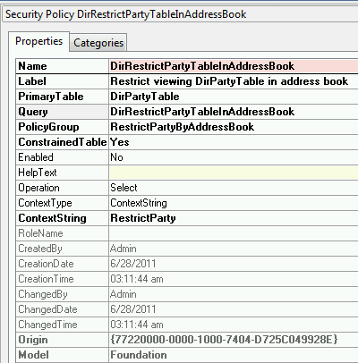

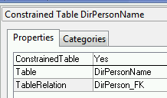
AOT/Security /Policies
Notes:
The slide shows a Policy in the Policies node, and its properties within the AOT.

Slide 66
Scenario: Create Default Security Policy
You have requested that a Microsoft Dynamics AX developer create a security policy to restrict access to Customer Group 20 for all users who has rights to this table.
Tips:
In the AOT, the developer will create:
A security policy by first creating a query that has a range.
The policy and set its Query property to the new query.
Roles and users that are associated to the policy can see only the subset of table records that are included by the range.
Procedure: Create Default Security Policy
Notes:
Scenario: Create Default Security Policy
You have requested that a Microsoft Dynamics AX developer create a security policy to restrict access to Customer Group 20 for all users who has rights to this table. A security policy reduces the range of table records that users in roles are allowed to access. In the AOT, the developer will create a security policy by first creating a query that has a range. Next he/she creates the policy and set its Query property to the new query. Roles and users that are associated to the policy can see only the subset of table records that are included by the range.
Procedure: Create Default Security Policy
To create a security policy restricting the CustGroup table, follow these steps:
Create a project to collect the AOT elements that you create for this topic.
Create a project named SecurityPolicy. The project can be either private or shared.
In the Projects window, right-click your project, and then click Open. This opens your project in its own window. You can close the Projects window.
Open the Microsoft Dynamics AX client and switch to company Contoso Entertainment Systems USA(CEU).
Switch to module Accounts Receivable and open Setup > Customers > Customer groups
Note: For more information about developing an extensible data security policy, refer to the Developer Documentation.
Note: For more information about developing an extensible data security policy, refer to the Developer Documentation.

Slide 67
Notes Continued
Notes:
Verify that the Major customers customer group has an ID value of 20. You will create a policy so that an application user can only work with data for this customer group.
Create a policy query by right-clicking the SecurityPolicy project, and then navigating to New > Query. Rename the new query to MajorCustomersPolicyQuery.
Locate Data Sources under the SecurityPolicy > MajorCustomersPolicyQuery node. Add a new data source.
In the Properties window for the new data source, set the Name property to CustGroup_1, and the Table property to CustGroup.
Right click the Ranges node and select New Range.
In the Properties window for the new range, set the Field property to CustGroup, and the Value property to 20.
Locate Fields under the MajorCustomersPolicyQuery > Data Sources > CustGroup_1 node.
In the Properties window for Fields, set the Dynamic property to Yes. The Yes value indicates that all fields are queried.
Create a security policy query by right-clicking the SecurityPolicy project, and then navigating to New > Security > Security Policy. Rename the new security policy to MajorCustomersPolicy.
14. In the Properties window for MajorCustomersPolicy, set the following properties:
Name = MajorCustomersPolicy
Label = Restrict data to major customers
PrimaryTable = CustGroup
Query = MajorCustomersPolicyQuery
PolicyGroup = Customer group based policy
ConstrainedTable = Yes
Enabled = Yes
Operation = All operations
15. Save and compile the security policy.
16. In this example, we will use Nancy who is assigned to the Sales manager role, in which Nancy has access to the CustGroup table.
17. Go to the desktop and double-click Nancy.cmd to log in as Nancy.
Note: The security policy is now ready for deployment and testing. Note that the ContextType property is currently set to the value ContextString, but the ContextString property is empty. This combination implies that when it is enabled, this security policy will always be applicable for all users.

Slide 68
Notes Continued
Notes:
Ensure logged into company Contoso Entertainment Systems USA (CEU).
Switch to module Accounts Receivable and open Setup > Customers > Customer groups.
Verify that Nancy can view ONLY the Major customers customer group (20).
Try to insert a new record with an ID of 100 and verify that the application user cannot add any other customer group.
When you try to insert a record you will see an error message in the Infolog as “Cannot create a record in Customer groups (CustGroup). Security policy permission denied”.

Slide 69
Scenario: Create Role Context Security Policy
You have requested a Microsoft Dynamics AX developer create a security policy to restrict access to Customer Group 20 for all users who belong to the Sales Manager role.
Procedure: Create Role Context Security Policy
Notes:
Scenario: Create Role Context Security Policy
You have requested a Microsoft Dynamics AX developer create a security policy to restrict access to Customer Group 20 for all users who belong to the Sales Manager role.
Procedure: Create Role Context Security Policy
To create a security policy restricting the CustGroup table for the Sales Manager role, follow these steps:
Change the ContextType property on the policy node MajorCustomersPolicy to RoleName:
Change the ContextType property on the policy node MajorCustomersPolicy to RoleName.
Set the RoleName property on the policy node to TradeSalesManager.
As Nancy, verify that the new security policy is enforced by the system:
In this example, we will use Nancy who is assigned to the Sales manager role in which has access to the CustGroup table.
Go to the desktop and double-click Nancy.cmd to log in as Nancy.
Note: The security policy is now ready for deployment and testing. Note that the ContextType property is currently set to the value ContextString, but the ContextString property is empty. This combination implies that when it is enabled, this security policy will always be applicable for all users.

Slide 70
Notes Continued
Notes:
Ensure logged into company Contoso Entertainment Systems USA (CEU).
Switch to module Accounts Receivable and open Setup > Customers > Customer groups.
Verify that Nancy can view ONLY the Major customers customer group (20). As April, verify that the new security policy is not enforced by the system:
In this example, we will use April who is assigned to the Accounts receivable clerk role which has access to the CustGroup table.
Go to the desktop and double click April.cmd to log in as April.
Ensure logged into company Contoso Entertainment Systems Europe (CEE).
Switch to module Accounts Receivable and open Setup > Customers > Customer groups.
Verify that April can view all Customer groups available.

Slide 71
Customizing Security
Overview
Procedure: Add a role
Procedure: Override permissions
Procedure: Create duties and privileges
Notes:
Note: Only the Microsoft Dynamics AX administrator can create or modify a role.
Note: The Roles form enables security administrators to interact with the roles set up in the Application Object Tree (AOT) without having to interact directly with the AOT. When changes are made to the roles form, the roles and duties changes will be made in the security node of the AOT in the user's current layer.

Slide 72
Customizing Security - Overview
Use out of the box roles.
These are the basis but customizations will require modifications and additions to these predefined roles.
Create a custom role that is based on an existing role.
Build a completely new role.
Only Administrators can create or modify a role.
Roles form to interact with the roles set up in the (AOT)
Changes made to the roles form affect the roles and duties in the security node of the AOT in the user's current layer.
Notes:
Customizing Security
Microsoft provides out of the box roles to help an administrator define security for his or her organization. These roles provide the basis for defining security in an organization. But the differences between companies, and the customizations made for a customer will require modifications and additions to these predefined roles.
If the security roles that are provided with Microsoft Dynamics AX do not meet the needs of your business, you can create new roles. You can create a custom role that is based on an existing role, or you can build a completely new role.
Note: Only the Microsoft Dynamics AX administrator can create or modify a role.
Note: The Roles form enables security administrators to interact with the roles set up in the Application Object Tree (AOT) without having to interact directly with the AOT. When changes are made to the roles form, the roles and duties changes will be made in the security node of the AOT in the user's current layer.

Slide 73
Scenario: Add a Role
You would like to create a new role for viewing customers.
This role should include:
The “Inquire into customer master” Duty
and the “View customer forecasts” Privilege.
Procedure: Add a Role
TIP: To include all of the permissions from another role, open the Security roles form, and drag the role that has the permissions that you want to the role that you are modifying. By dragging one role to another, you create a hierarchical relationship, where the main role contains all of the permissions of the sub-role. If you change the permissions of a sub-role, the changes also apply to the main role.
Notes:
Scenario: Add a Role
You would like to create a new role for viewing customers. This role should include the “Inquire into customer master” Duty and the “View customer forecasts” Privilege.
Procedure: Add a Role
To create a new role, follow these steps:
Go to System administration > Setup > Security > Security Roles.
On the upper-left corner of the Roles form, click New.
In the AOT name field, type "CustBaseResponsible".
In the Name field, type "Customer base responsible".
In the Description field, type "Allow user to review customer master information."
Under Role content, click Add.
Optionally, change the View by field to "Role" to view the list of roles.
In the Find field, type "Inquire into customer master" and then press the enter key.
Notice the "Inquiry into customer master" Duty is found.
Select the check box next to the "Inquire into customer master" duty.
In the Find field, type "View customer forecasts" and then press enter.
Notice the "View customer forecasts" Privilege has been found.
Select the check box next to the "View customer forecasts" Privilege.
On the Add privileges to role form, click Close.
Notice the "Inquire into customer master" Duty and the "View customer forecasts" Privilege are added to the "Customer base responsible" Role.
On the Roles form, click Close.
Note: AOT names must contain only alphanumeric or underscore characters. AOT names cannot begin with a number, and they cannot contain special characters or spaces.

Slide 74
Notes Continued
Notes:
Tip: To include all of the permissions from another role, open the Security roles form, and drag the role that has the permissions that you want to the role that you are modifying. By dragging one role to another, you create a hierarchical relationship, where the main role contains all of the permissions of the sub-role. If you change the permissions of a sub-role, the changes also apply to the main role.

Slide 75
Scenario: Override Permissions
You are asked to add the “Maintain applicant master” duty to the Human Resources Assistant role but only allow them to View applicants and not change them.
April is one of the users that should be assigned to the Human Resources Assistant role.
Notes:
Scenario: Override Permissions
You are asked to add the “Maintain applicant master” duty to the Human Resources Assistant role but only allow them to View applicants and not change them. April is one of the users that should be assigned to the Human Resources Assistant role.

Slide 76
Scenario: Override Permissions
Procedure: Override Permissions
To add the “Maintain applicant master” duty to the HHRR Assistant role.
To add April to the Human Resources Assistant role.
Verify that April can see and create new Applicants.
To override permissions on the Human Resources role to allow only View rights.
Verify that April can no longer create new Applicants.
NOTE: Overrides for securable objects are not associated with specific duties or privileges. If you apply an override, the access level for the object is set for the role, regardless of the access levels specified by the duties and privileges to that role.
Notes:
Procedure: Override Permissions
To add the “Maintain applicant master” duty to the Human Resources Assistant role, follow these steps:
Open System administration > Setup > Security > Security roles.
Select the Human Resources Assistant role.
In the Role Content pane, click Add.
Change the View by field to "Role" to view the list of roles.
In the Find field, type Maintain applicant master and then press the enter key.
Notice the "Maintain applicant master" Duty is found.
Select the check box next to the "Maintain applicant master" duty.
Click Close.
To add April to the Human Resources Assistant role, follow these steps:
Open System administration > Setup > Security > Assign users to roles.
Select the Human Resources Assistant role.
Click the Manually assign/exclude users button.
Select April.
Click the Assign to role button.

Slide 77
Notes Continued
Notes:
Close form.
Verify that April can see and create new Applicants:
Log in as April by double-clicking April.cmd.
Open Human resources>Common>Recruitment>Applicants.
Click New Applicant
Enter First name as John
Enter Middle name as A
Enter Last name as Doe
Click Save
To override permissions on the Human Resources role to allow only View rights, follow these steps:
Open System administration > Setup > Security > Security roles.
Select the Human Resources Assistant role to override permissions for.
Select the “Maintain applicant master” duty
Click Override permissions.
26. Expand Tables/Fields.
27. Select HCMAPPLICANT table
28. Clear the Do not override check box.
29. Change the Override access level field to View
To apply the overridden access level to all roles, click the Apply to all roles link.
30. Click Close when you are finished.
Verify that April can no longer create new Applicants:
31. Log in as April by double clicking April.cmd
32. Open Human resources>Common>Recruitment>Applicants.
33. Click New Applicant.
34. Notice the fields are dimmed.
Note: Overrides for securable objects are not associated with specific duties or privileges. If you apply an override, the access level for the object is set for the role, regardless of the access levels specified by the duties and privileges to that role.

Slide 78
Scenario: Create Duties and Privileges
April has changed jobs within the organization and will be responsible for maintaining customer collections. She will need to be removed from her current roles and assigned to a role with access to maintain and view customer collections.
You notice that there are no roles, duties, or privileges available for this task so you need to create a new role, duties, and privileges.
Procedure: Create Duties and Privileges
Remove current roles for April
Create a new duty
Create a new privilege for the new duty
Add permissions to the new privilege
Create a second privilege for the new duty
Add permissions to the new privilege
Create a new role and assign new duty
Assign new role to April and Verify.
Notes:
Scenario: Create Duties and Privileges
April has changed jobs within the organization and will be responsible for maintaining customer collections. She will need to be removed from her current roles and assigned to a role with access to maintain and view customer collections.
You notice that there are no roles, duties, or privileges available for this task so you need to create a new role, duties, and privileges.
Procedure: Create Duties and Privileges
First, remove current roles for April:
Open System administration > Setup > Common > Users.
Select April and Edit
Remove all roles but Employee and System user
Create a new duty which will contain privileges and permissions for collections:
Open System administration > Setup > Security > Security privileges.
Select Process cycles>Conversion cycle.
Note: The Process cycles are used as a way to organize your duties and privileges and in this example we will create this duty under the Conversion cycle

Slide 79
Notes Continued
Notes:
Now create a new duty:
Right click>New duty
Give duty name of “TestMaintainCustomerCollections”
Now create two a new privileges for the new duty:
Select new duty “TestMaintainCustomerCollections”
Right click>New privilege
Give privilege name of “TestViewCollectionCases”
Now add permissions to the new privilege:
Select privilege “TestViewCollectionCases”
Click Add to add permissions.
Expand Rich Client>Accounts receivable>Common>Collections
Select “Collection cases” and give FULL CONTROL access
Now create a second privilege for the new duty:
Select new duty “TestMaintainCustomerCollections”
Right-click>New privilege
Give privilege name of “TestViewCollectionActivities”
10. Now add permissions to the new privilege:
Select privilege “TestViewCollectionCases”
Click Add to add permissions.
Expand Rich Client>Accounts receivable>Common>Collections.
Select Collection activities and give FULL CONTROL Access.
11. Close form.
Create a new role and assign new duty:
12. Open System administration > Setup > Security > Security roles
13. Click New.
14. Enter AOTName as TestCollections
15. Enter Name as TestCollections.
16. In the Role content pane, click Add.
17. View by Process cycle

Slide 80
Notes Continued
Notes:
18. Expand Conversion cycle.
19. Select “TestMaintainCustomerCollections” duty.
20. Close form.
Assign new role to April:
21. Open System administration > Setup > Common>Users
22. Select April.
23. In the User’s role pane, click Assign roles.
24. Select “TestCollections” role.
25. Close form.
Verify that April can work with collections:
26. Log in as April by double-clicking April.cmd.
27. Open Accounts receivable>Common>Collections.
28. Click Collection cases to verify if opens.
29. Click Collection activities to verify if opens.
30. Close Microsoft Dynamics AX sessión.

Slide 81
Segregation of Duties
Overview
To prevent users having access to conflicting duties.
Scenario: Create Segregation of Duties (SoD) Rule
You are told that users may not have the rights to both maintain purchase orders and maintain vendor payments as this is a violation of company regulations.
Procedure: Create Segregation of Duties Rule
Create new rule
Alicia currently belongs to the Purchasing agent role which has the “Maintain purchase orders” duty and you attempt to add her to the Accounts payable payments clerk role which has the “maintain vendor payments” duty.
You should receive an error “The assignment of user ALICIA to role Accounts payable payments clerk resulted in a conflict with segregation of duties rules. Would you like to resolve the conflict now?”
Deny the assignment
Periodically run the “Verify compliance of userrole assignments report” to ensure you are in compliance with company regulations.
Notes:
Segregation of Duties
You can set up segregation of duties rules to make sure that a user does not have access to conflicting duties (permissions required to perform a task or service for a job). For example, you might set up a rule specifying one person cannot both acknowledge the receipt of goods and pay the vendor.
Scenario: Create Segregation of Duties (SoD) Rule
You are told that users may not have the rights to both maintain purchase orders and maintain vendor payments as this is a violation of company regulations. You create a Segregation of duties rule that enforces this policy.
Procedure: Create Segregation of Duties Rule
Follow the steps below to create a SoD rule which restricts users from having the maintain purchase orders and maintain vendor payments duties:
Open System administration>Security>Segregation of duties>Segregation of duties rules
Create new rule.
Name = Vendor payments violation
First duty = Maintain purchase orders
Second duty = Maintain vendor payments

Slide 82
Notes Continued
Notes:
Severity = High
Security risk = Violation
Security mitigation = Do not allow
3. Close form.
Alicia currently belongs to the Purchasing agent role which has the “Maintain purchase orders” duty and you attempt to add her to the Accounts payable payments clerk role which has the “maintain vendor payments” duty:
1. Open System administration>Common>Users.
2. Select Alicia and Edit.
3. In the User’s role pane, click Assign roles.
4. Select the Accounts payable payments clerk role.
5. Click OK.
You should receive an error “The assignment of user ALICIA to role Accounts payable payments clerk resulted in a conflict with segregation of duties rules. Would you like to resolve the conflict now?
7. Click Yes.
8. In this window, you can deny the assignment or allow the assignment.
9. Deny the assignment.
10. Close form.
Best Practice: This is why it is important to assign duties directly to roles as opposed to privileges as you are able to set up segregation of duties.
Best Practice: You should periodically run the “Verify compliance of userrole assignments report to ensure you are in compliance with company regulations.

Slide 83
Test Your Knowledge
The class will complete this section.

Slide 84
Chapter Review
Match the following Microsoft Dynamics AX 2012 security concept names with their descriptions.
c. Roles
1. Group of duties for a job function
a. Process Cycle
2. Group of duties which can be optionally used when assigning duties to roles
e. Duties
3. A responsibility to perform one or more tasks or services for a job
4. Group of related entry points with associated access levels
d. Privileges
5. Group of base objects and required permissions For example: Form permissions
b. Permissions
a. Process Cycle
b. Permissions
c. Roles
d. Privileges
e. Duties

Slide 85
Chapter Review
Where is the role-based security set up stored?
( ) Application Object Tree (AOT)
( ) Application files
( ) Security file
( ) Security tables
True or False? It is recommended that record level security is used to secure data in Microsoft Dynamics AX because the extensible data security policy framework is being deprecated in a future release.
( ) True
( ) False

Slide 86
Chapter Review
What authentication types are available to Microsoft Dynamics AX 2012? (Select all that apply)
( ) Active Directory users
( ) Active Directory groups
( ) Claims users
( ) SQL users

Slide 87
Chapter Review
Which of the following statements are true? (Select all that apply)
( ) Overrides for securable objects are not associated with specific duties or privileges.
( ) Overrides for securable objects are associated with specific duties or privileges.
( ) If you apply an override, the access level for the object is set for the role, regardless of the access levels specified by the duties and privileges to that role.
( ) If you apply an override, the access level for the object is set for the role, only if access levels are specified by the duties and privileges to that role.

Slide 88
Chapter Review
True or False? Before an organization hierarchy can be used for security it must be given the security hierarchy purpose
( ) True
( ) False
True or False? It is recommended to assign privileges directly to roles as opposed to duties.
( ) True
( ) False

Slide 89
Chapter Review (Answers)
Match the following Microsoft Dynamics AX 2012 security concept names with their descriptions.
c. Roles
1. Group of duties for a job function
a. Process Cycle
2. Group of duties which can be optionally used when assigning duties to roles
e. Duties
3. A responsibility to perform one or more tasks or services for a job
4. Group of related entry points with associated access levels
d. Privileges
5. Group of base objects and required permissions For example: Form permissions
b. Permissions

Slide 90
Chapter Review (Answers)
Where is the role-based security set up stored?
(x) Application Object Tree (AOT)
( ) Application files
( ) Security file
( ) Security tables
True or False? It is recommended that record level security is used to secure data in Microsoft Dynamics AX because the extensible data security policy framework is being deprecated in a future release.
( ) True
(x) False

Slide 91
Chapter Review (Answers)
What authentication types are available to Microsoft Dynamics AX 2012? (Select all that apply)
(x) Active Directory users
(x) Active Directory groups
(x) Claims users
( ) SQL users

Slide 92
Chapter Review (Answers)
Which of the following statements are true? (Select all that apply)
(x) Overrides for securable objects are not associated with specific duties or privileges.
( ) Overrides for securable objects are associated with specific duties or privileges.
(x) If you apply an override, the access level for the object is set for the role, regardless of the access levels specified by the duties and privileges to that role.
( ) If you apply an override, the access level for the object is set for the role, only if access levels are specified by the duties and privileges to that role.

Slide 93
Chapter Review (Answers)
True or False? Before an organization hierarchy can be used for security it must be given the security hierarchy purpose
(x) True
( ) False
True or False? It is recommended to assign privileges directly to roles as opposed to duties.
( ) True
(x) False

Slide 94
Licensing Microsoft Dynamics AX 2012
Microsoft Dynamics AX 2012 is licensed under a pricing model that is simple, flexible, and focused on the needs of the individual roles in your company.
The offered functionality is included in the Microsoft Dynamics AX 2012 server; there is only one server edition. Your price varies according to the value received by each employee—not the level of access they enjoy. You select and pay for the level of interaction that each user needs.
http://www.microsoft.com/en-us/dynamics/erp-buy-ax-software.aspx
Review the Microsoft Dynamics AX 2012 pricing and licensing guide (PDF, 183 KB)

Slide 95
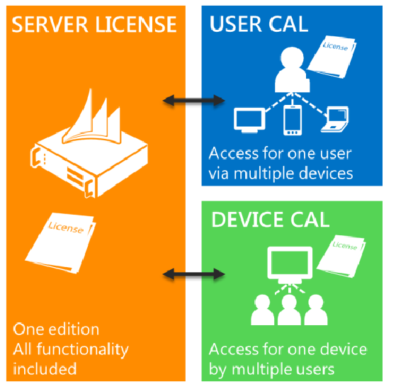
All Microsoft Dynamics AX 2012 customers need to license:
Microsoft Dynamics AX 2012 solution functionality, which is licensed through the Microsoft Dynamics AX 2012 Server license, and…
access to the Microsoft Dynamics AX 2012 solution functionality by users or devices, which is licensed through Client Access Licenses (CALs).
Any time a user directly or indirectly accesses the solution functionality, that user must be licensed by a User CAL (which licenses a specific user for access via multiple devices) or by a Device CAL (which licenses access through a specific device by any user).
Notes:
CAL:
User vs Device

Slide 96
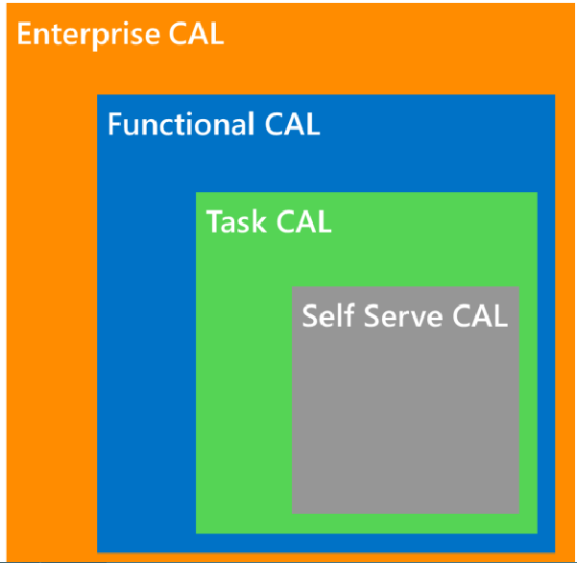
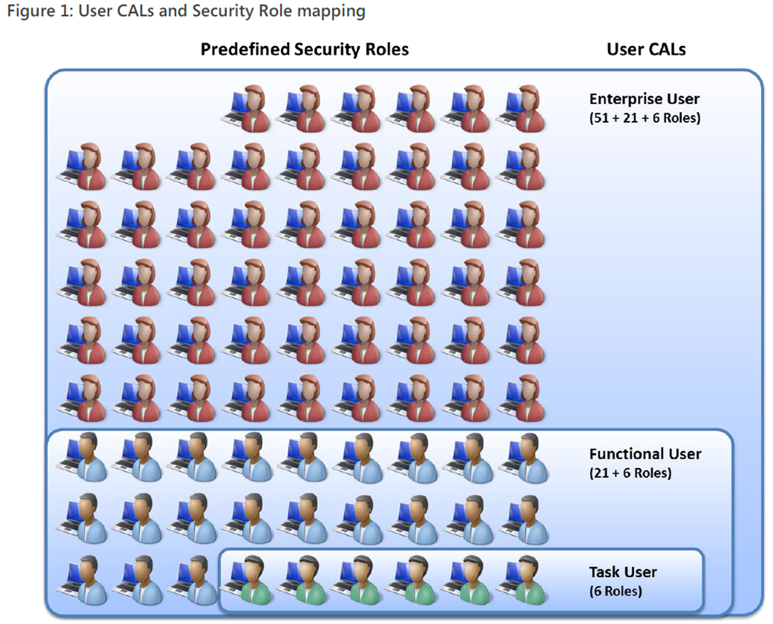
Available CALS
Security roles and licensing white paper
Notes:
CALs Available and mapped to Security Roles

Slide 97
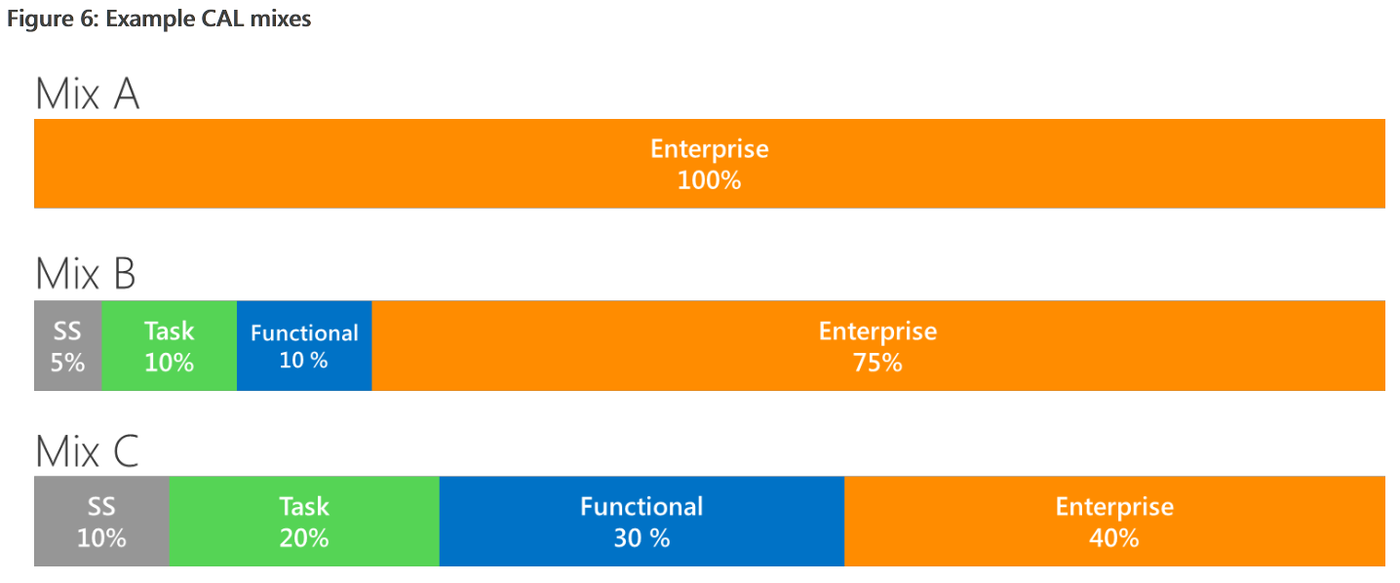
Possible alternatives for licensing CALs
Notes:
Mix depends on business needs.

Slide 98
Chapter 3 Summary
In this chapter we discussed the following topics:
The security system and elements
Types of authentication
Authorization using role-based security
Security policies
Segregation of duties

